Slide 1
Cost aware resource management in distributed cloud data centers
Master Thesis
Technical University of Vienna
Author: Andreas Egger
MatrNr.: 0626885
Supervisor: Univ. Prof. Dr. Ivona Brandic

Slide 2
Overview
Introduction
Main Contributions
Methodological Approach
Forecasting
Simulation Scenario
Results
Conclusion

Slide 3
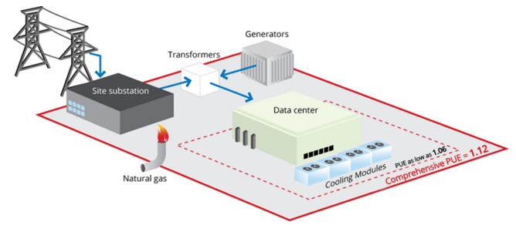
Introduction
Huge power consumption in data centers
1.3% of global electricity use in 2010
198 TWh -> 3 x City of Los Angeles
$9.9B @ 50 $ / MWh
Application scenarios
IaaS / PaaS cloud providers
Amazon EC2
Google Compute Cloud
Microsoft‘s Azure
Public cloud providers
Notes:
Los Angeles Power Consumption 2010 [1]: 68.255 TWh
Population of Los Angeles [2]: 18,550,288
[1] US city power consumption http://ecdms.energy.ca.gov/elecbycounty.aspx
https://www.quora.com/How-much-electricity-does-an-industrialized-city-of-1-million-people-consume
[2] https://en.wikipedia.org/wiki/Demography_of_the_United_States

Slide 4
Introduction
Need for energy cost reductions – 2 approaches
Increase energy efficiency
Improve power usage effectiveness (PUE) of data centers
Increase efficiency of servers, cooling system etc.
Reduce electricity costs
Cost and power aware scheduling algorithms
Electricity price changes across power markets

Slide 5
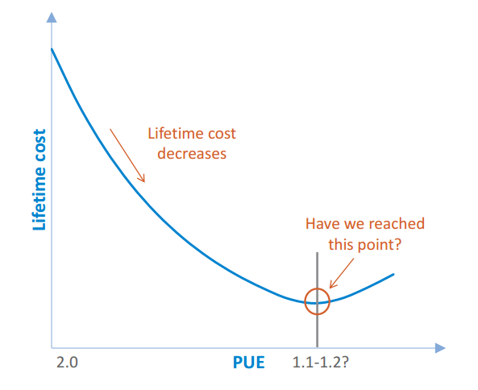
Introduction
CAPEX vs OPEX turn around?

Slide 6
Main Contributions
Framework for cost optimization in Multi Cloud Environments
Decision support for handling VM migrations
Advanced cloud scheduler for handling tradeoff between cost optimization and SLA penalties
Large scale evaluation of forecasting methods based on electricity price data from various energy markets

Slide 7
Methodological Approach
Evaluation of energy price data
Day ahead and real time price comparison
Comparison of price time series from different energy markets
Automated forecast model selection algorithm
Data preprocessing
Build and compare models based on data
Cloud scheduling and utility function
Define criteria to include in utility function
Define utility function for scheduler
Simulation scenario
Set simulation parameters and boundary conditions

Slide 8
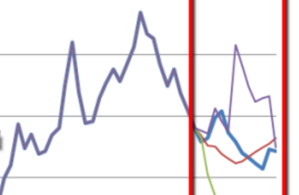
Forecasting
Goals
Build Forecast models for energy price prediction
Suitable for day ahead and real time energy prices
Automated model selection
Large scale forecast model evaluation
Selection of relevant and baseline models
Performance evaluation over extended time range

Slide 9
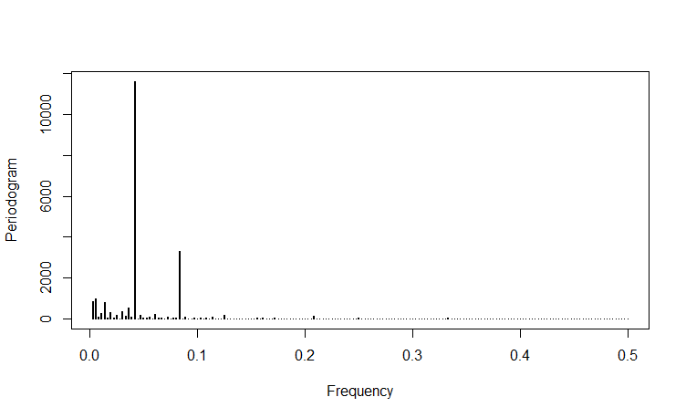
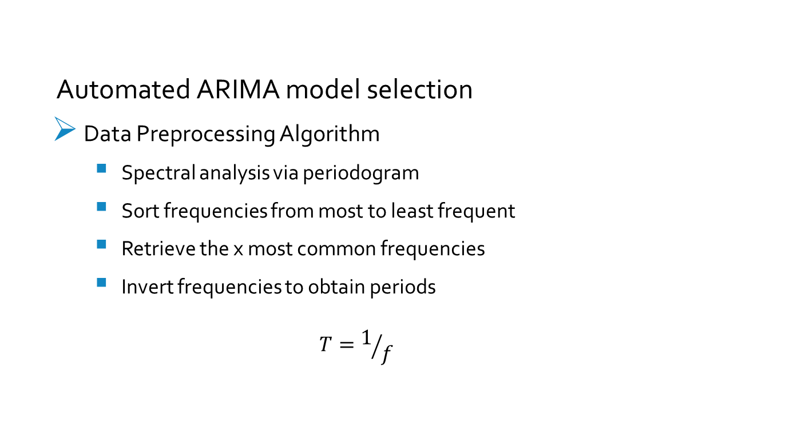
Forecasting
Automated ARIMA model selection
Data Preprocessing Algorithm
Spectral analysis via periodogram
Sort frequencies from most to least frequent
Retrieve the x most common frequencies
Invert frequencies to obtain periods
$$T=1/f$$

Slide 10

Forecasting
Automated ARIMA model selection
Data Preprocessing
Determine seasonality in the dataset
Retrieve frequencies available in periodogram
Get target period if available
Calculate period
$$T=1/f$$

